Slide 1
Reading Group
ClayCode的一些总结 and ML in EC
2021/12/06
Presenter: Tianyang Niu

Slide 2
Outline
1
Clay Code
2
ML in EC

Slide 3
Outline
1
Clay Code
2
ML in EC

Slide 4
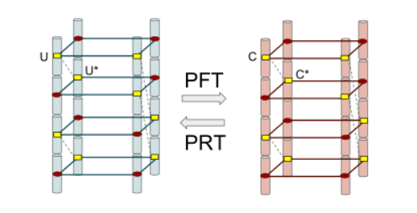
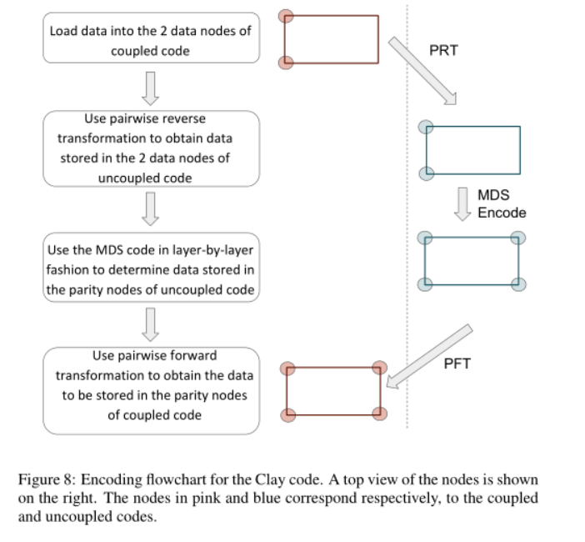
Clay Code
(18条消息) Clay Codes — 从生成矩阵的角度来看_sinat_22510827的博客-CSDN博客

Slide 5
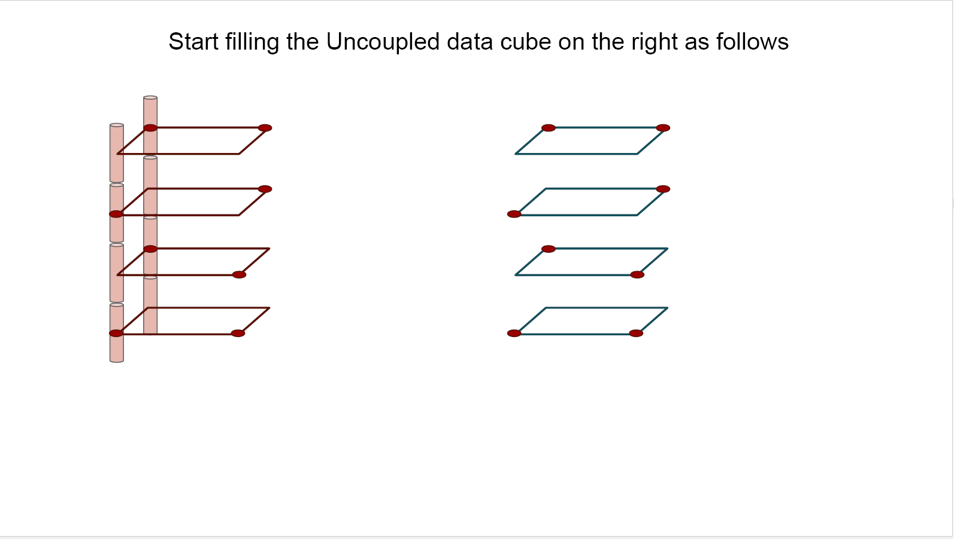
Clay Code

Slide 6
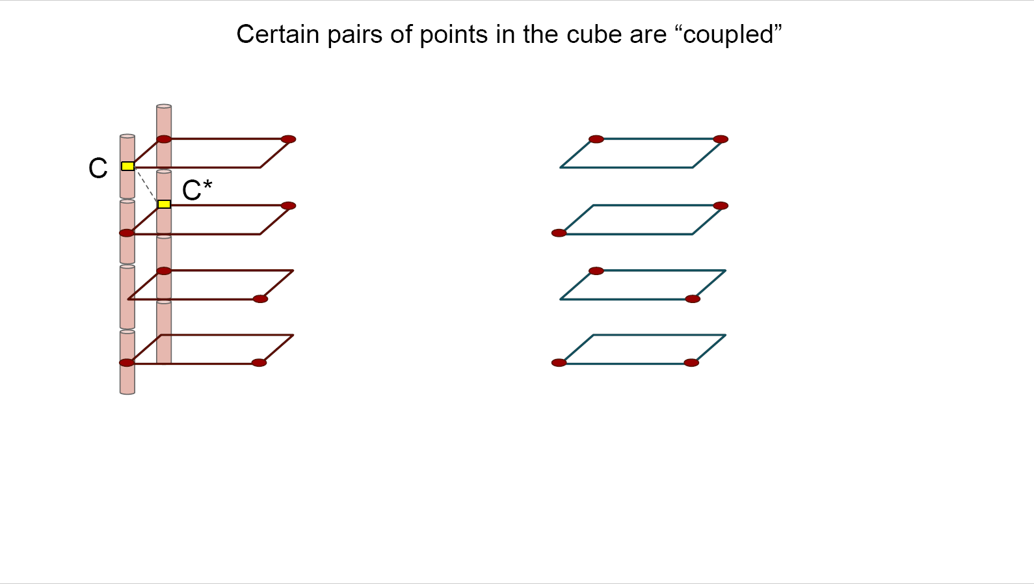
Clay Code

Slide 7
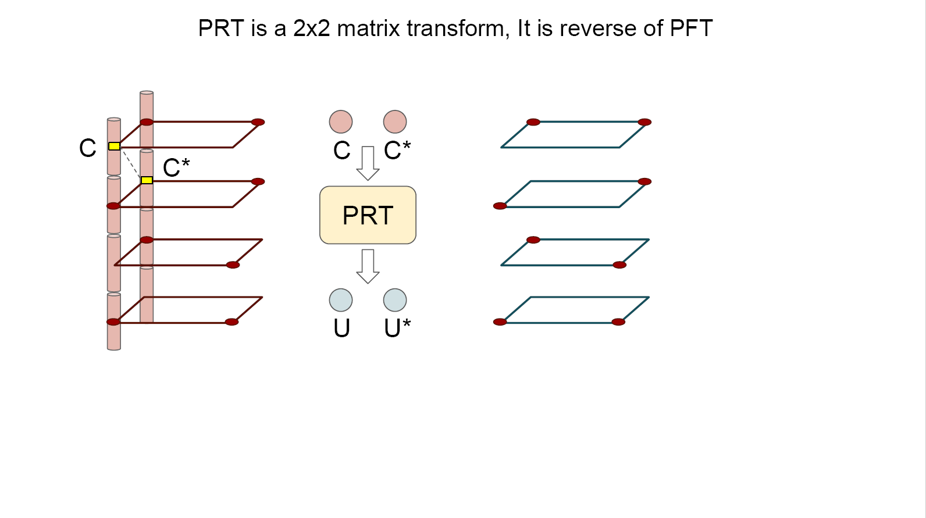
Clay Code

Slide 8
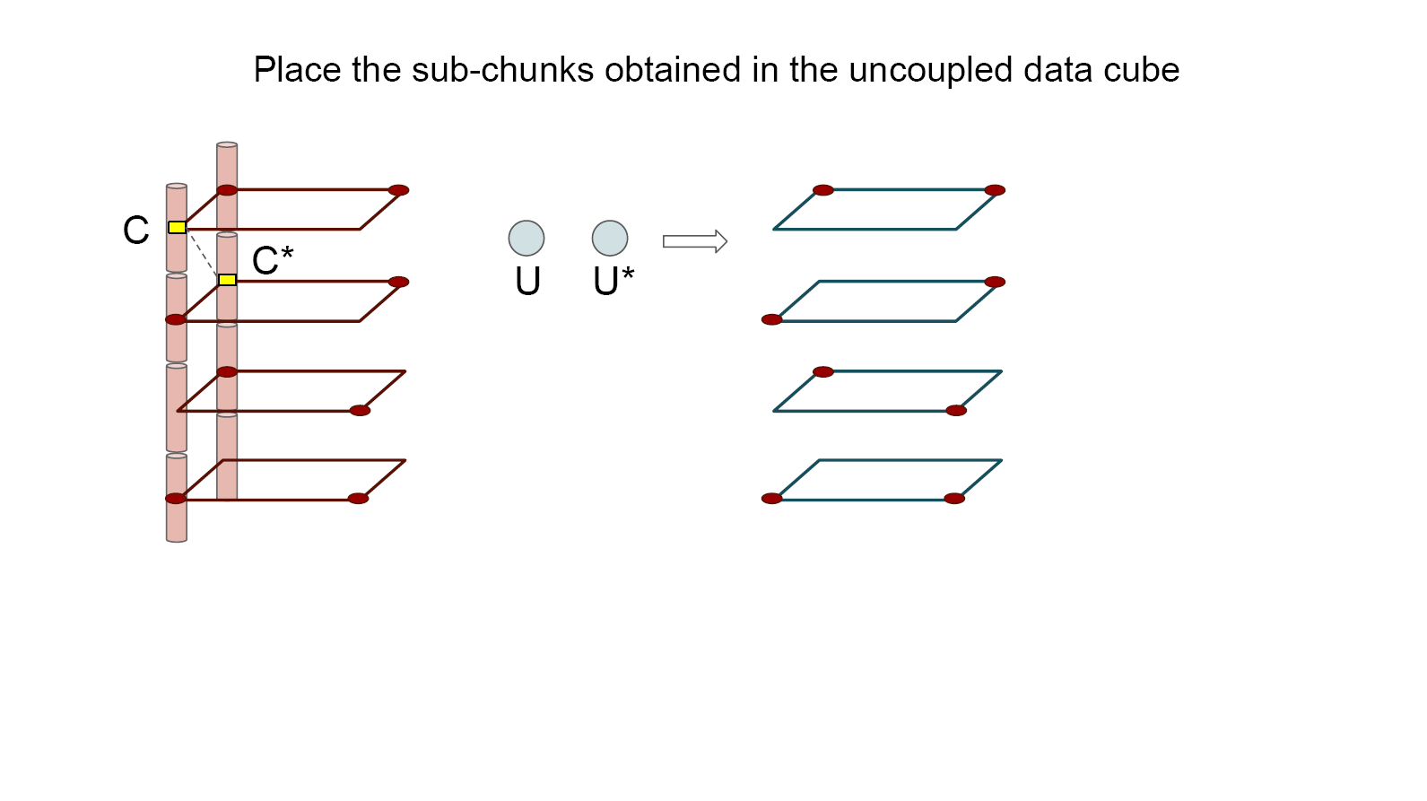
Clay Code

Slide 9
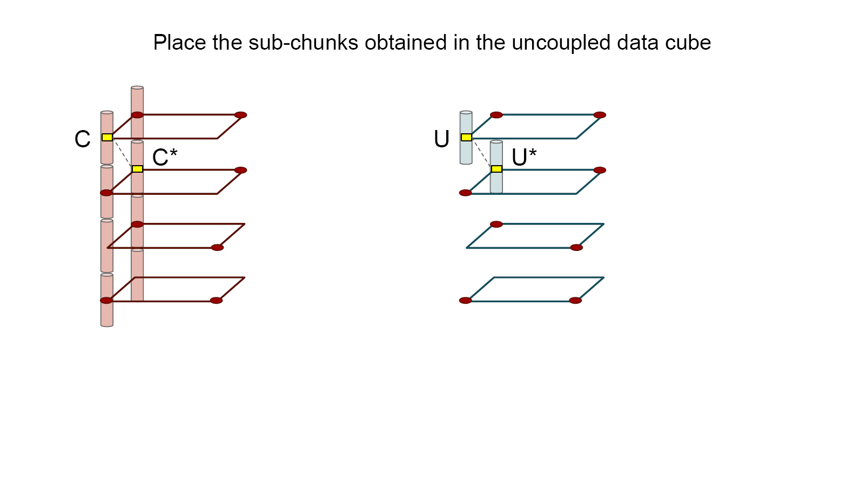
Clay Code

Slide 10
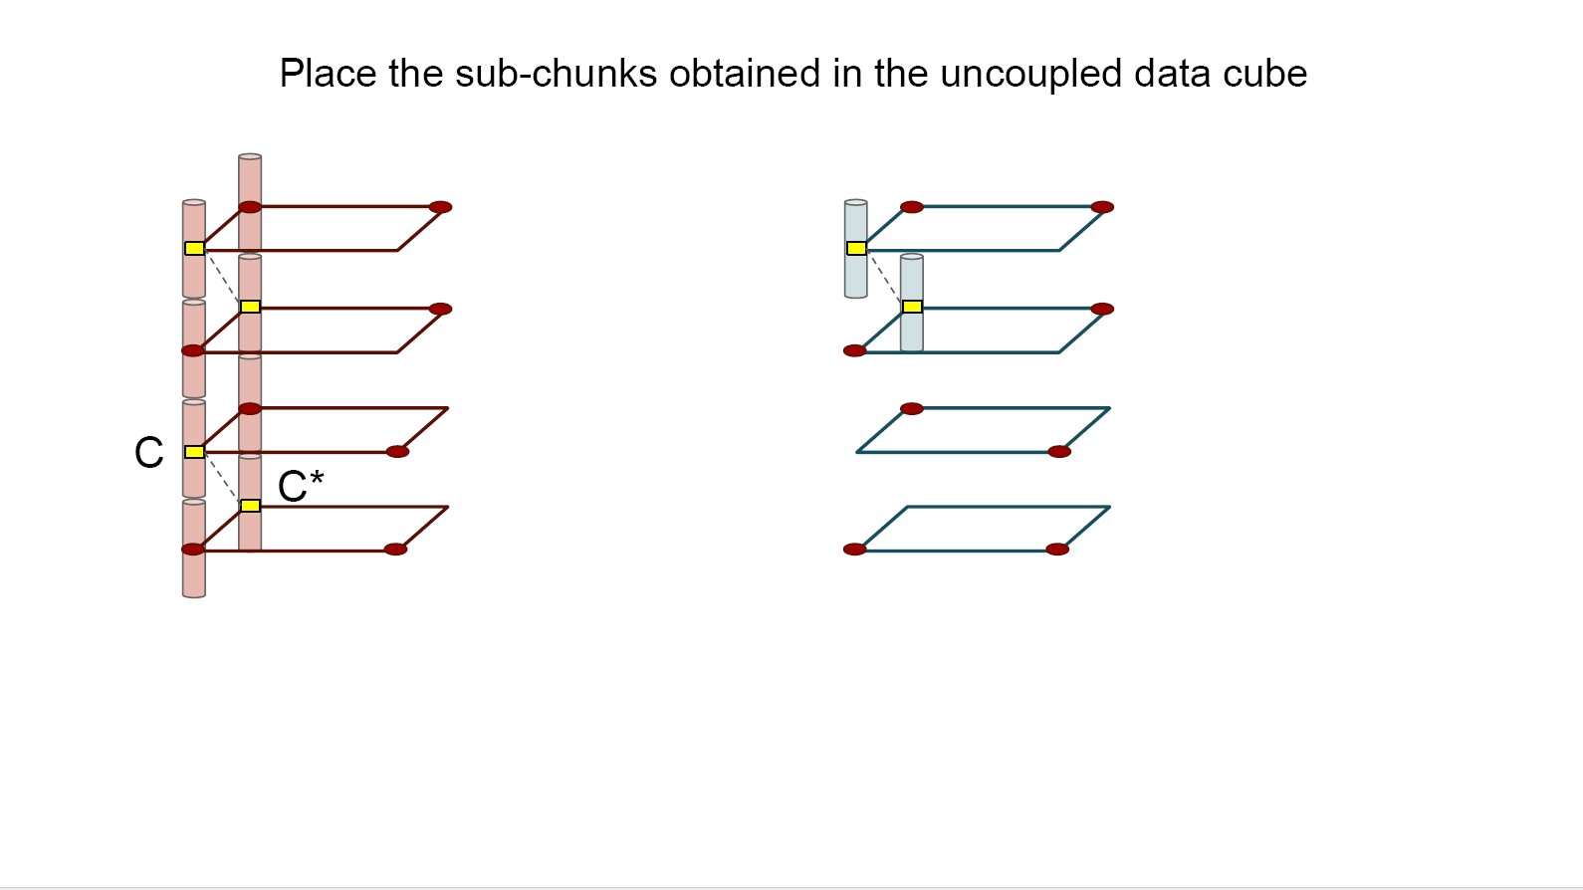
Clay Code

Slide 11
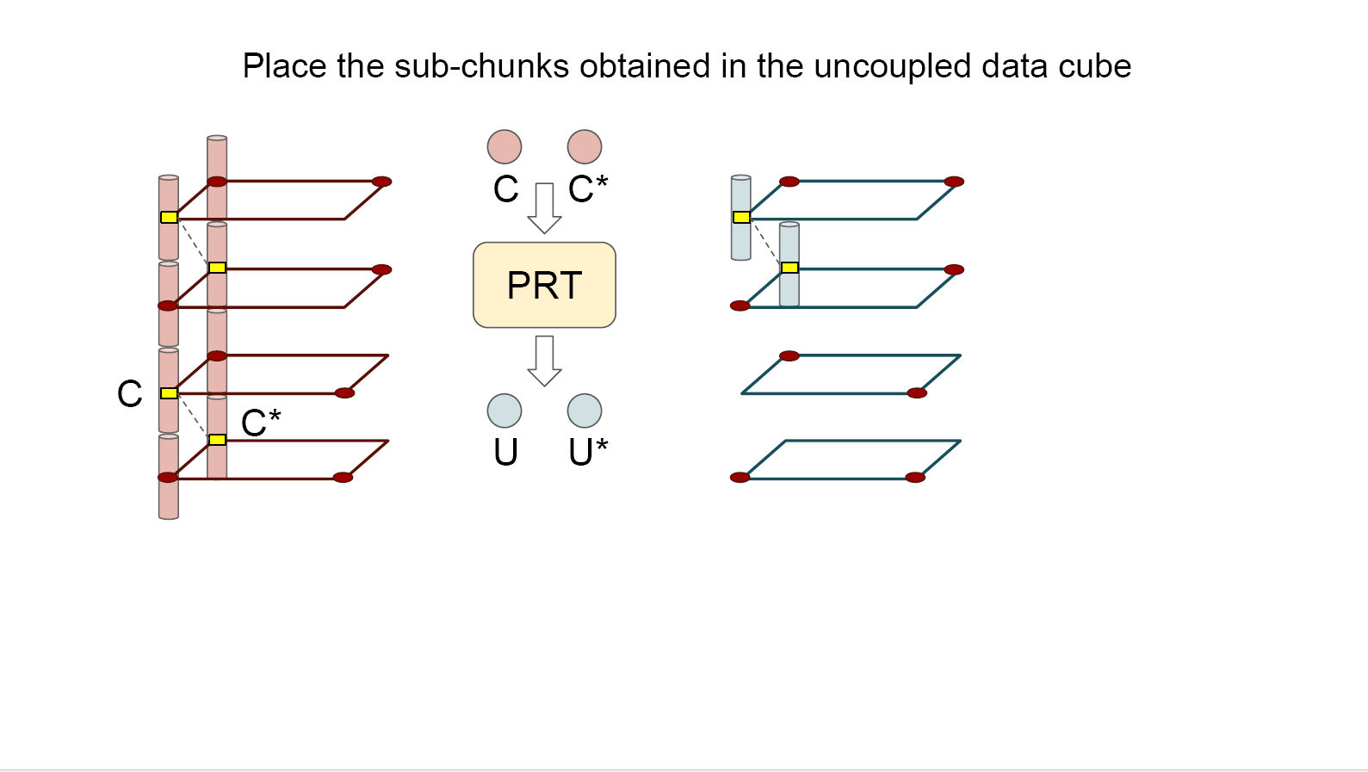
Clay Code

Slide 12
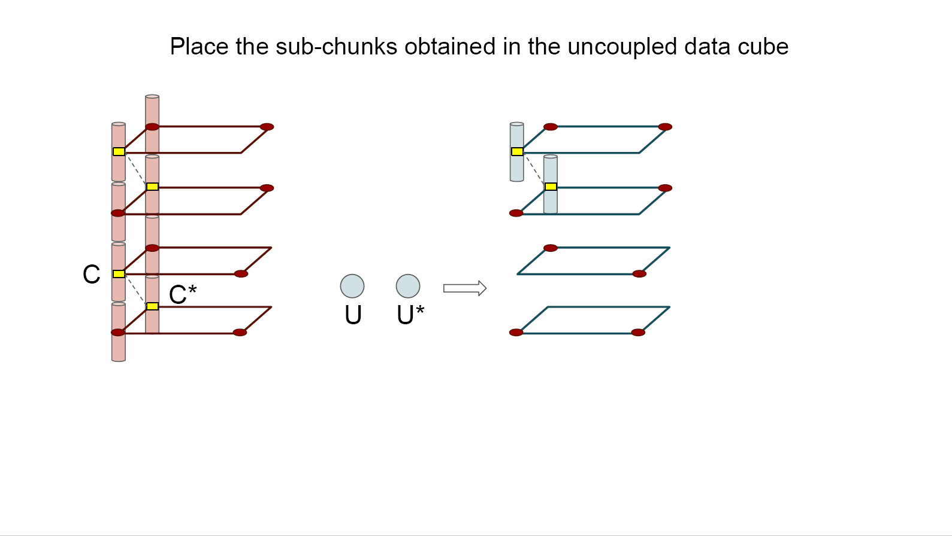
Clay Code

Slide 13
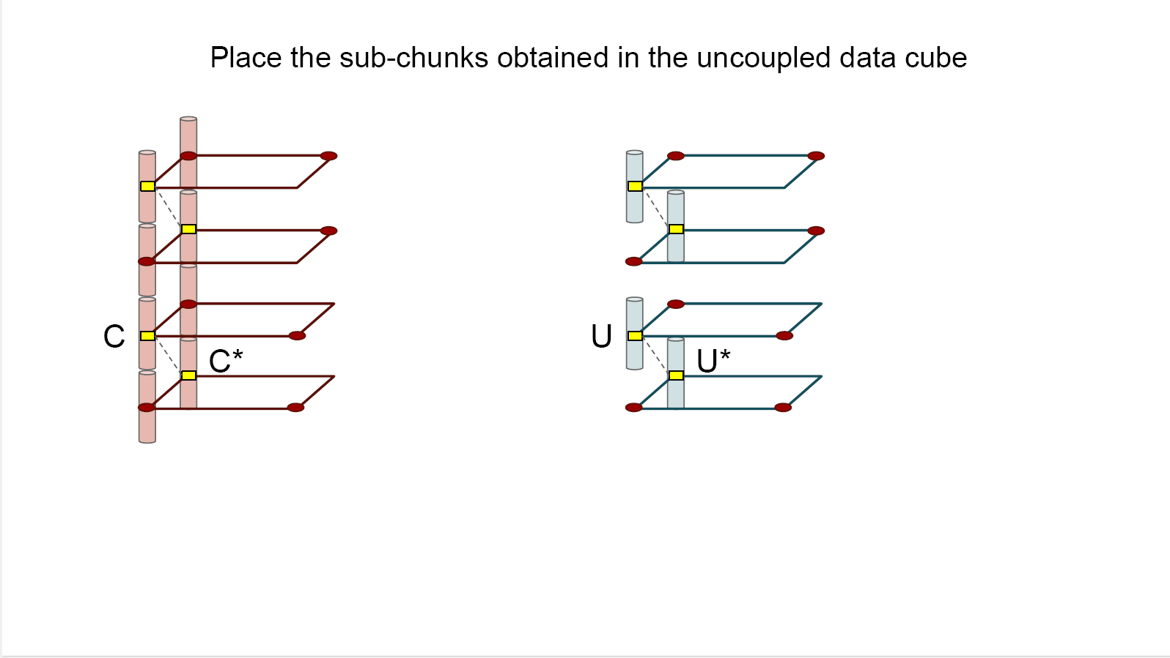
Clay Code

Slide 14
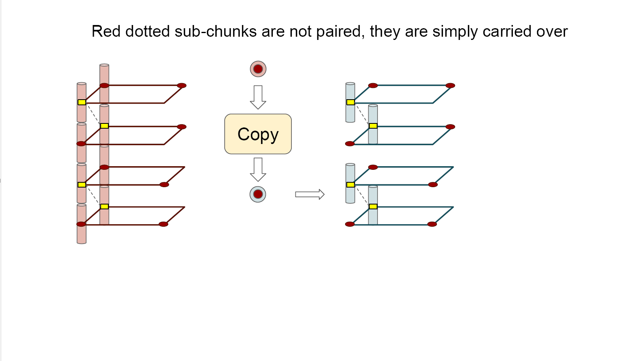
Clay Code

Slide 15
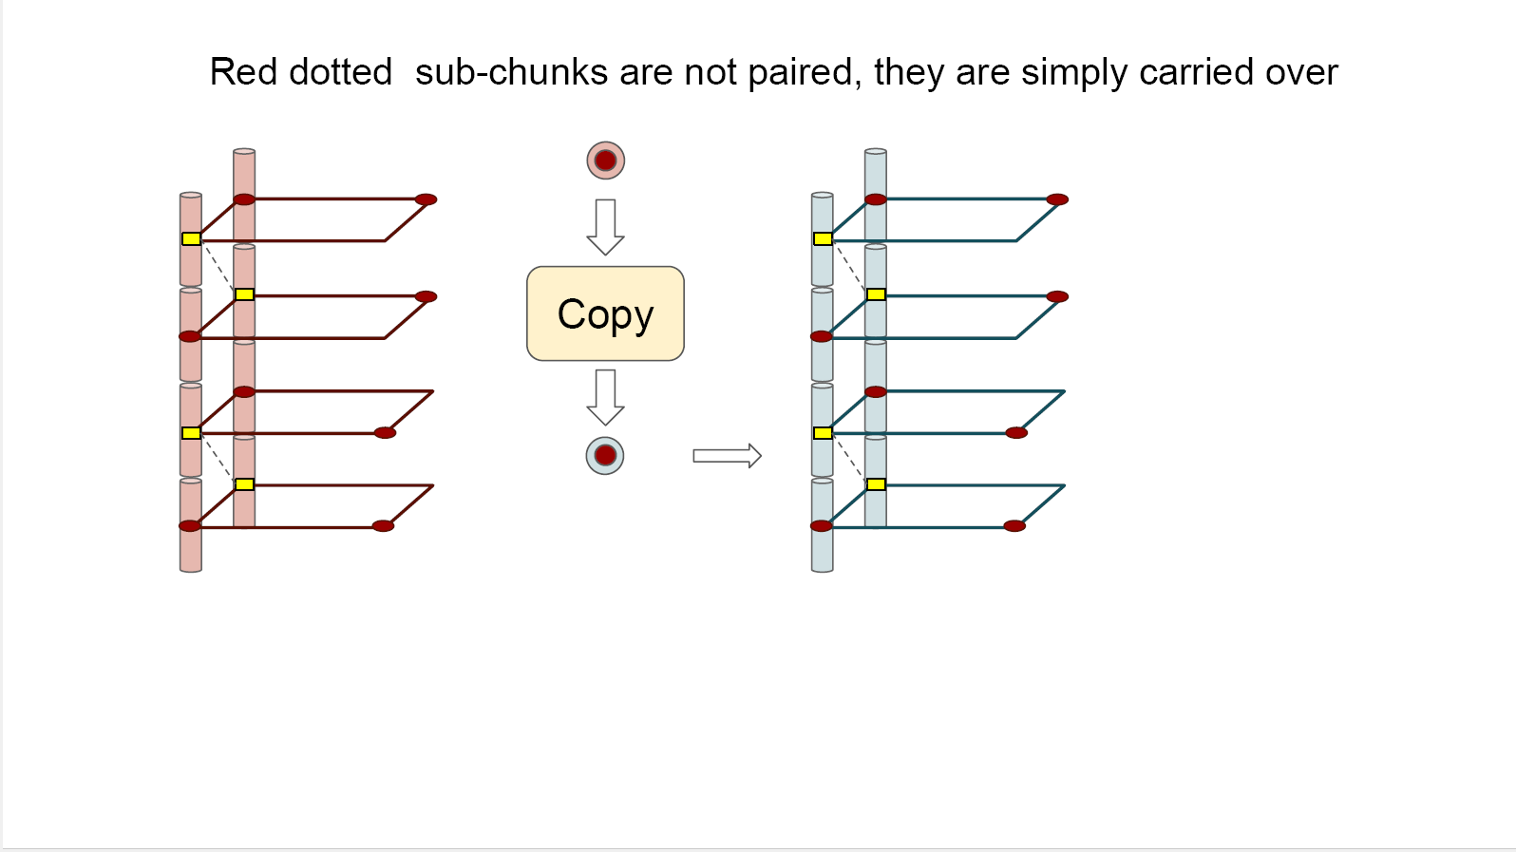
Clay Code

Slide 16
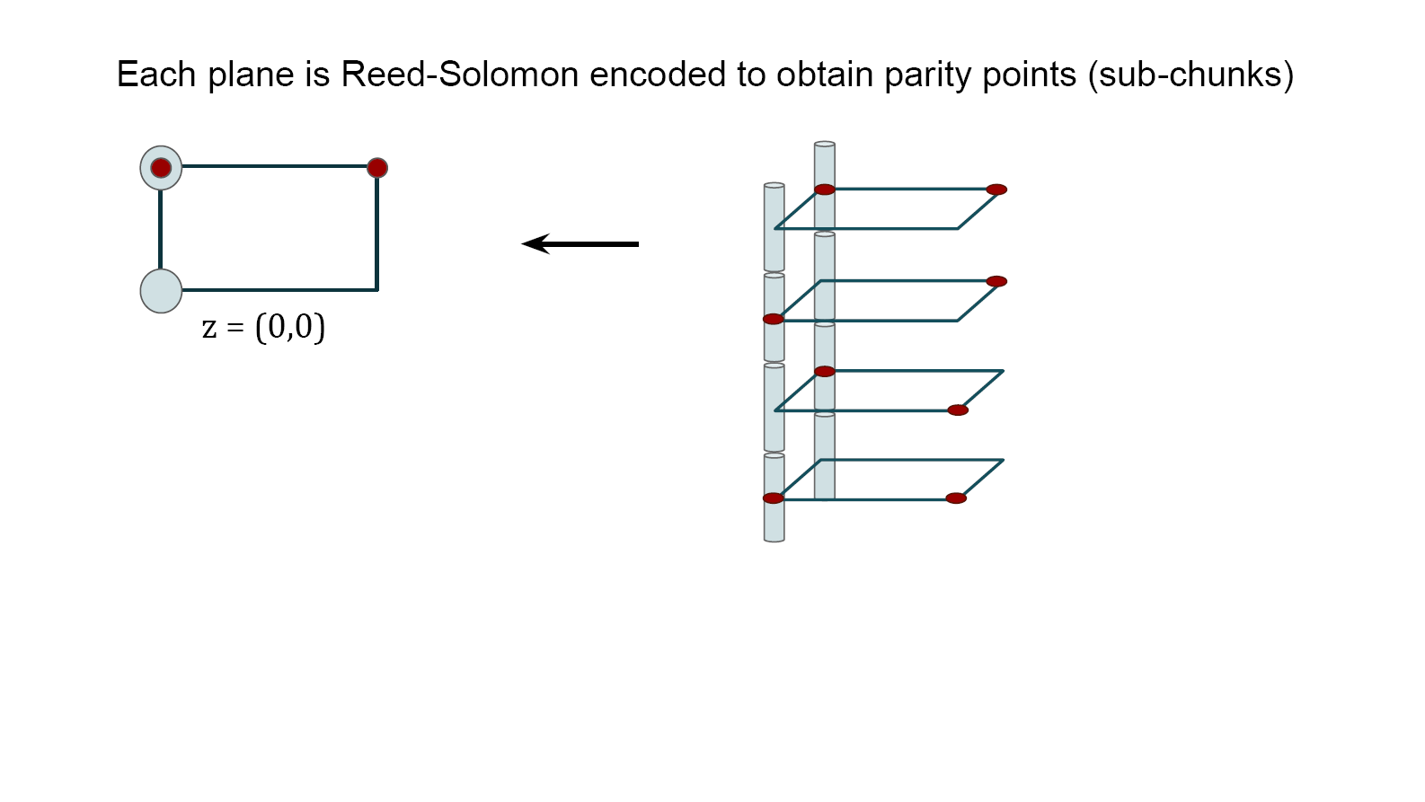
Clay Code

Slide 17
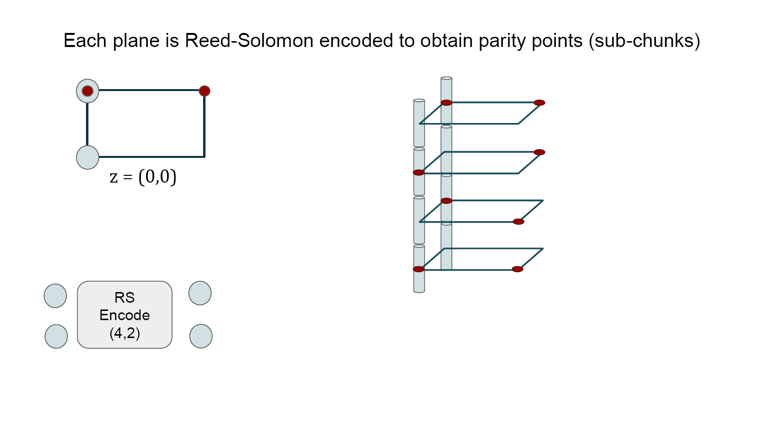
Clay Code

Slide 18
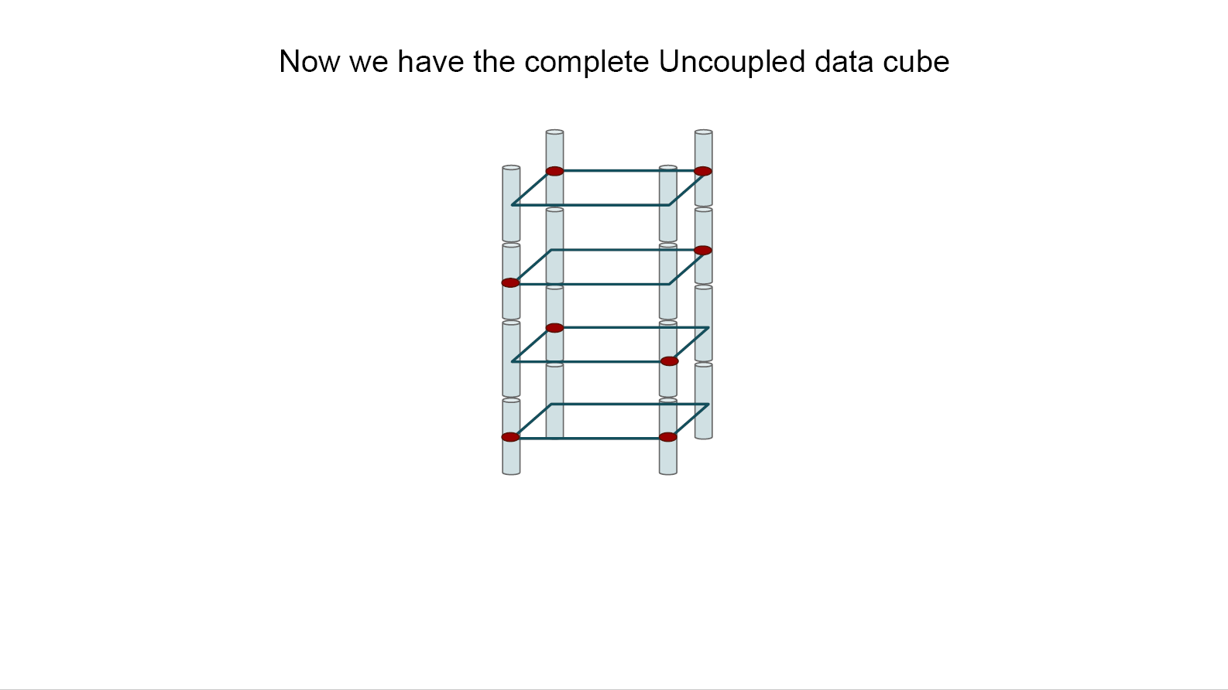
Clay Code

Slide 19
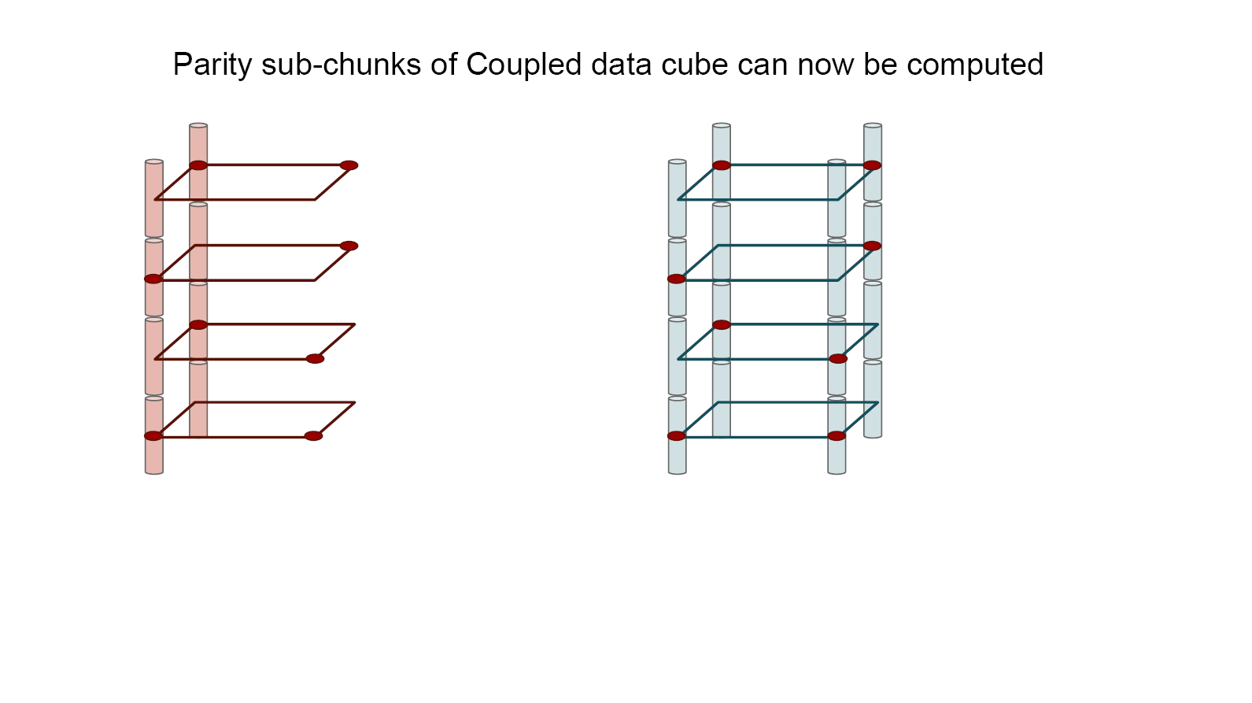
Clay Code

Slide 20
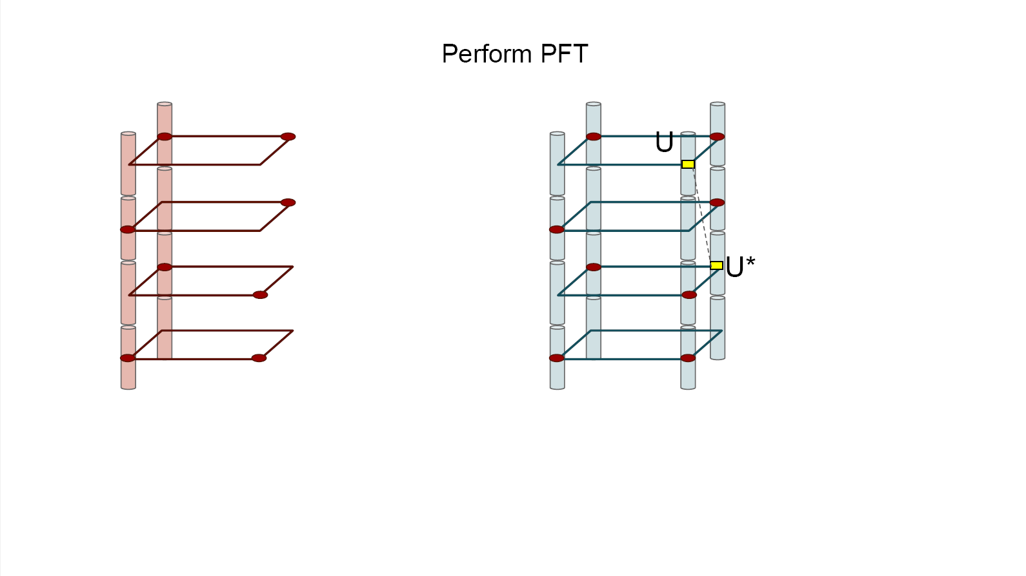
Clay Code

Slide 21
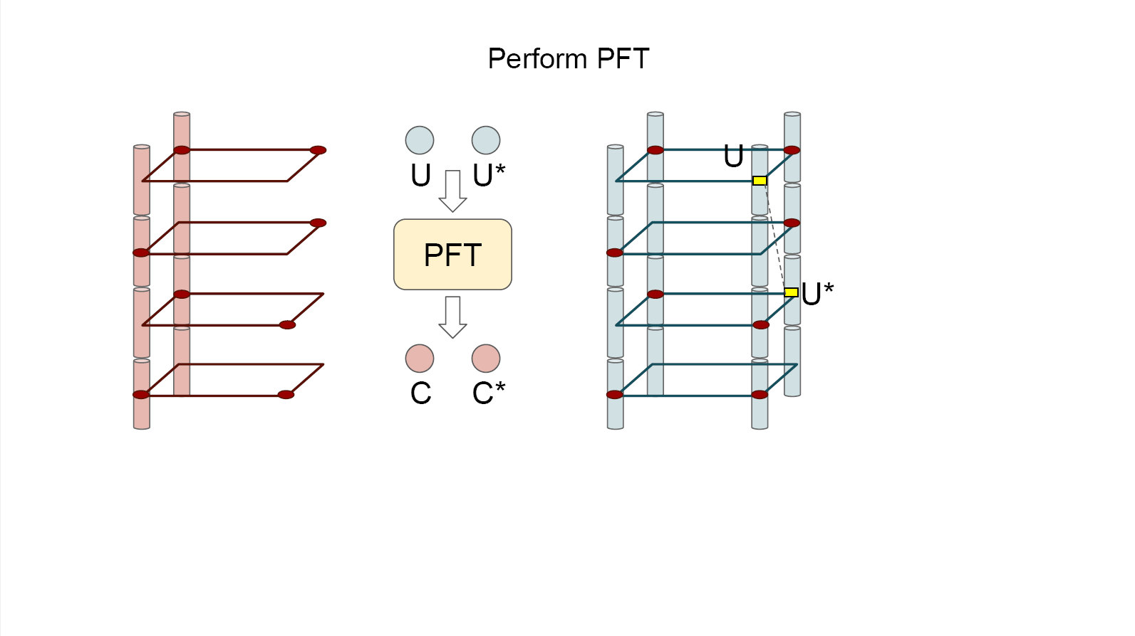
Clay Code

Slide 22
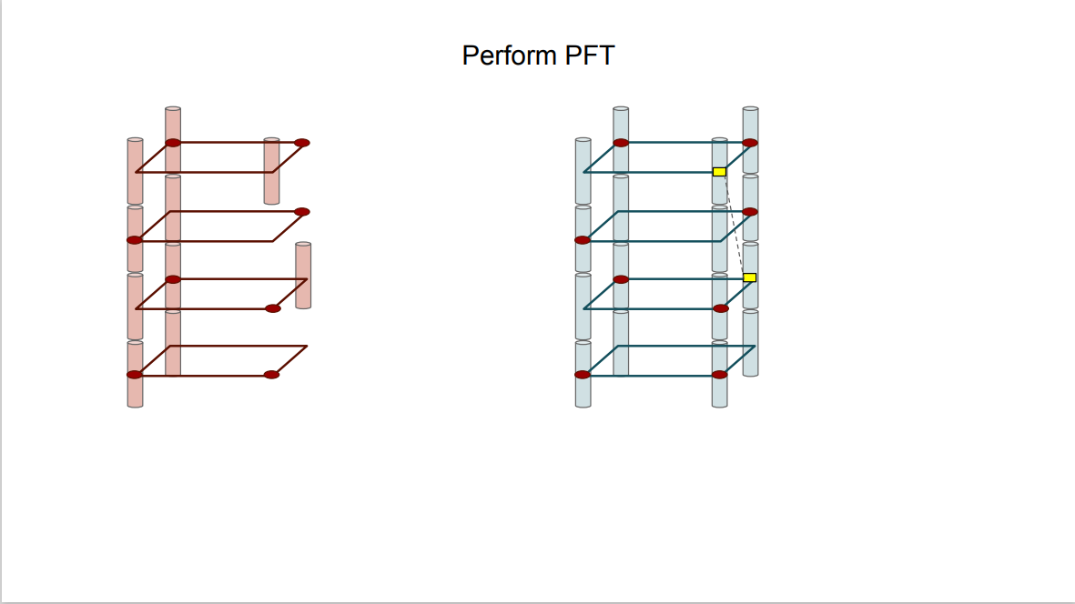
Clay Code

Slide 23
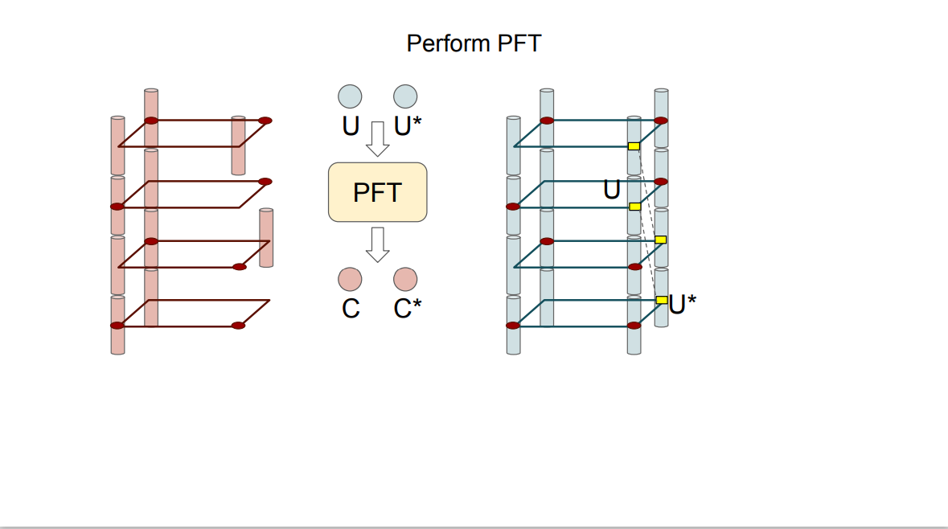
Clay Code

Slide 24
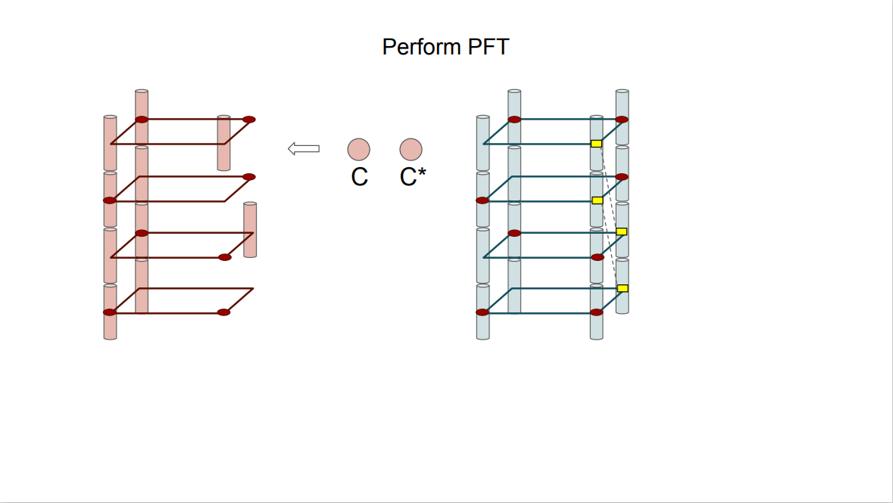
Clay Code

Slide 25
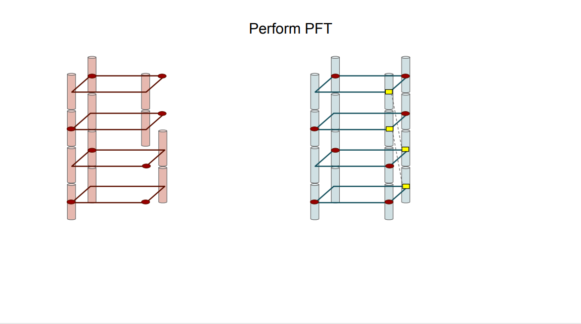
Clay Code

Slide 26
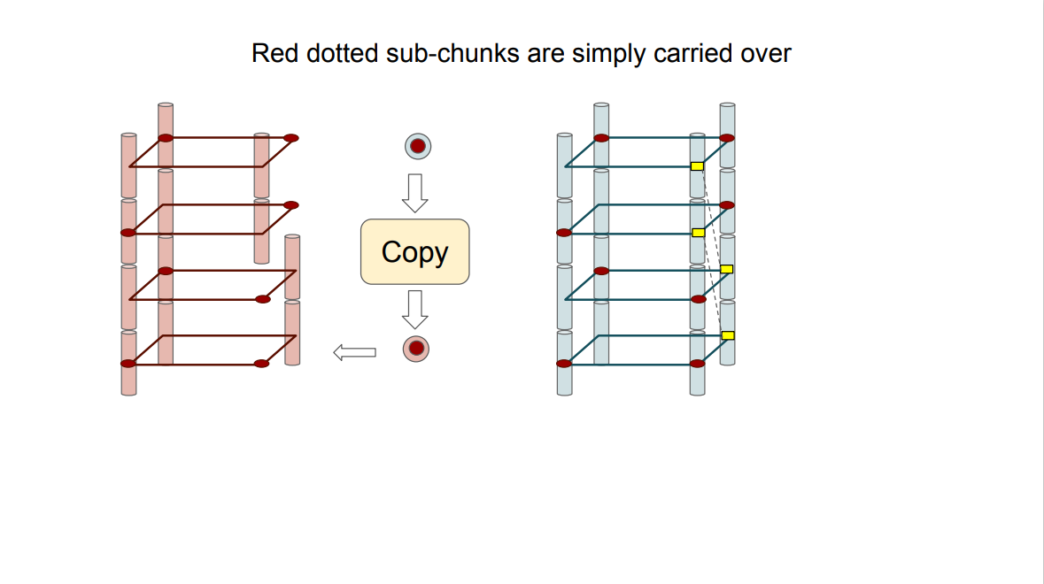
Clay Code

Slide 27
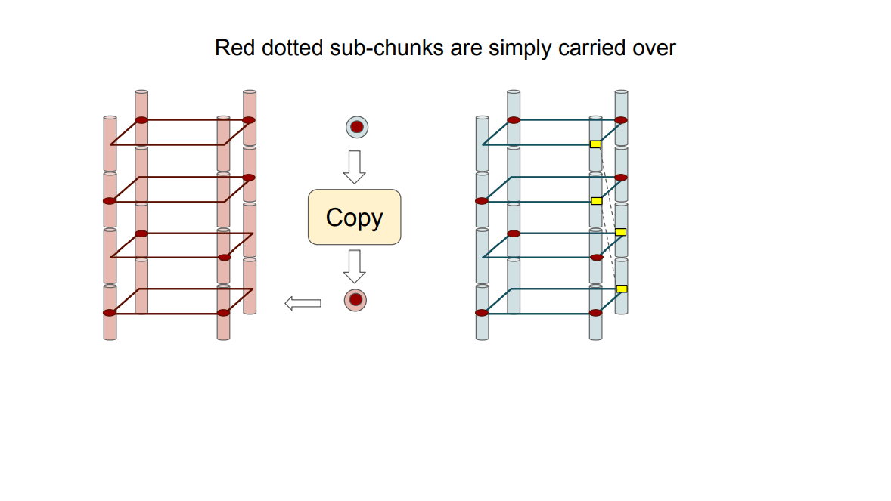
Clay Code

Slide 28
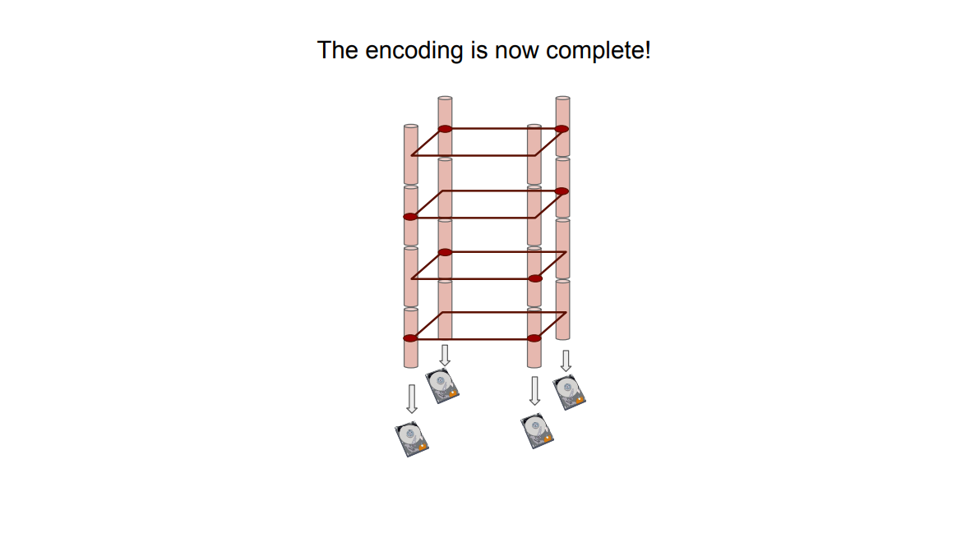
Clay Code

Slide 29
Outline
1
Clay Code
2
ML in EC

Slide 30
ML in EC
Proactive drive failure prediction for large scale storage systems. MSST 2013（CCF-B）
利用神经网络，磁盘故障预测率达到95%
Hard Drive Failure Prediction Using Classification and Regression Trees. DSN 2014（CCF-B）
磁盘故障预测率达到95%，可解释性更强，FAR降到0.1%
RAIDShield: Characterizing, Monitoring, and Proactively Protecting Against Disk Failures. FAST 2015(CCF-A)
对RAID系统做的故障预测，识别即将发生故障的RAID组，然后替换
Predicting Disk Replacement towards Reliable Data Centers. SIGKDD 2016(CCF-A)
磁盘故障预测率达到98%

Slide 31
ML in EC
Proactive error prediction to improve storage system reliability. USENIX ATC 2017(CCF-A)
对扇区错误的预测，用的随机森林，90%，FAR较高
Disk Failure Prediction in Data Centers via Online Learning. ICPP 2018(CCF-A)
离线的变为在线的，随机森林，解决模型老化问题
Improving Service Availability of Cloud Systems by Predicting Disk Error USENIX ATC 2018(CCF-A)
过去的模型是都是要么正确，要么错误，但是而还能多时候是灰色的，超时，分区错误。
使用该模型预测磁盘在不久的将来出现错误的可能性，在线预测模型，用在了微软的云系统上。对发生错误的可能性做了个排序

Slide 32
ML in EC
Fast Predictive Repair in Erasure-Coded Storage. DSN 2019(CCF-B)
在预测的基础上，通过耦合两种修复方法，迁移，重建来加快修复速度

Slide 33
THANK YOU

